Slide 1


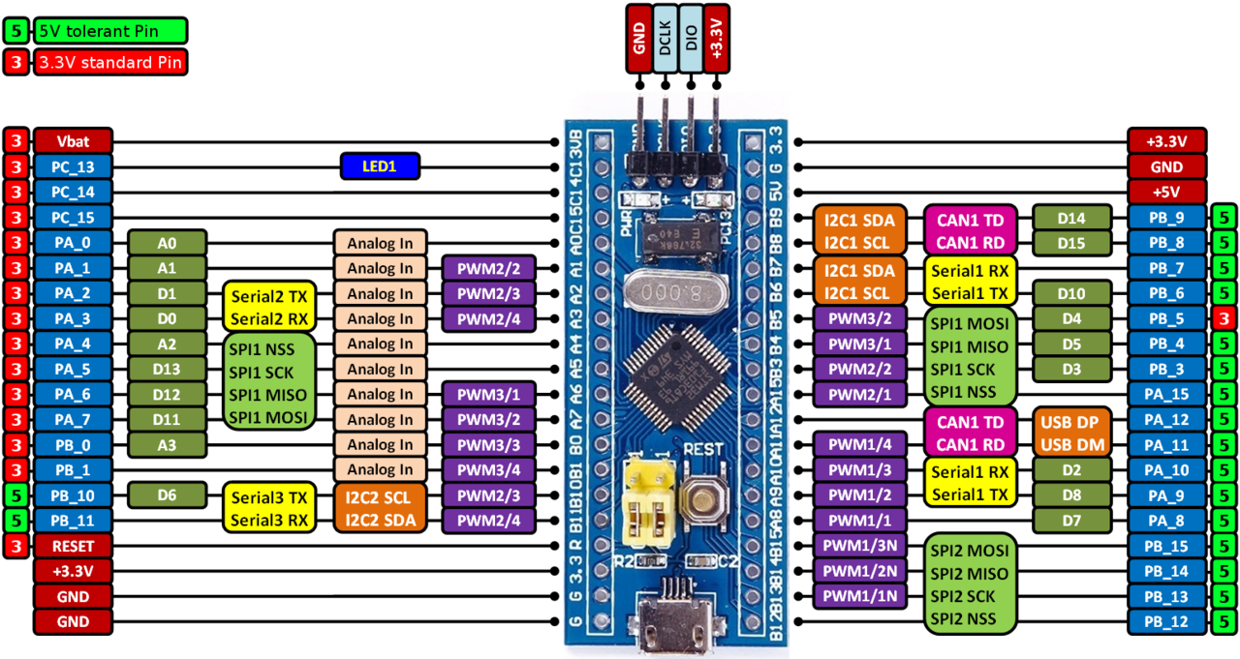
STM32 – ARM CORTEX M
LAB 1:
GPIO – LED - 7SEG
STM32 EMBEDDED PROGRAMING
DO TRUNG HAU

Slide 2

CONTENTS
1. GENERAL PURPOSE INPUT OUTPUT
2. HAL LIBRARY & GPIO COMMANDS
3. CONTROL LED & 7 SEG LED IN PARALLEL
4. CONTROL LED & 7 SEG LED IN SERIAL
STM32 EMBEDDED SYSTEMS
ARM CORTEX M

Slide 3
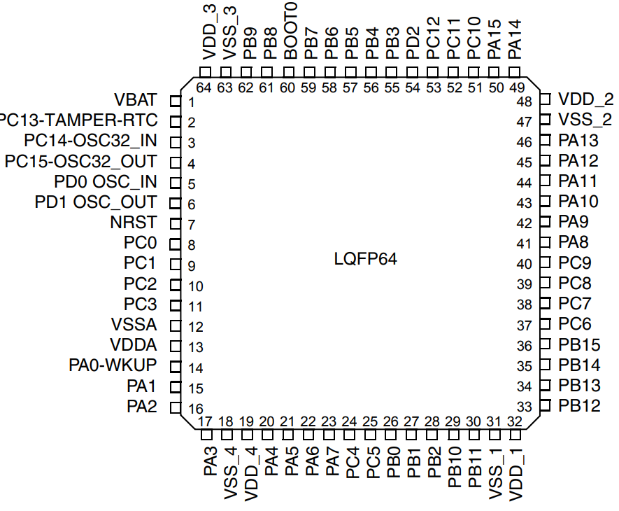
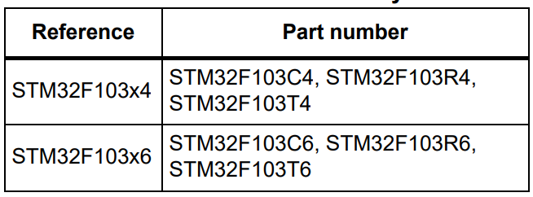
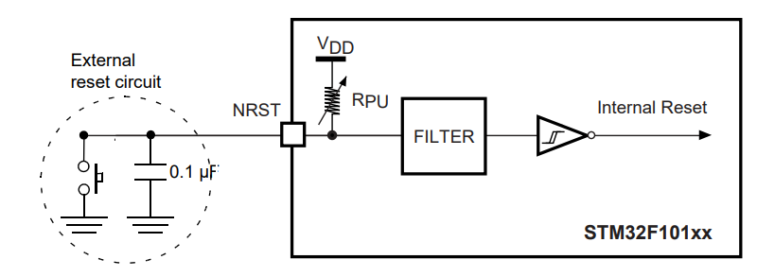
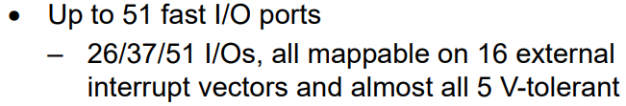
LAB 1: GPIO – LED – 7SEG IN DIRECT FORM
1. GPIO OF STM32F103C6
STM32 EMBEDDED SYSTEMS
ARM CORTEX M

Slide 4
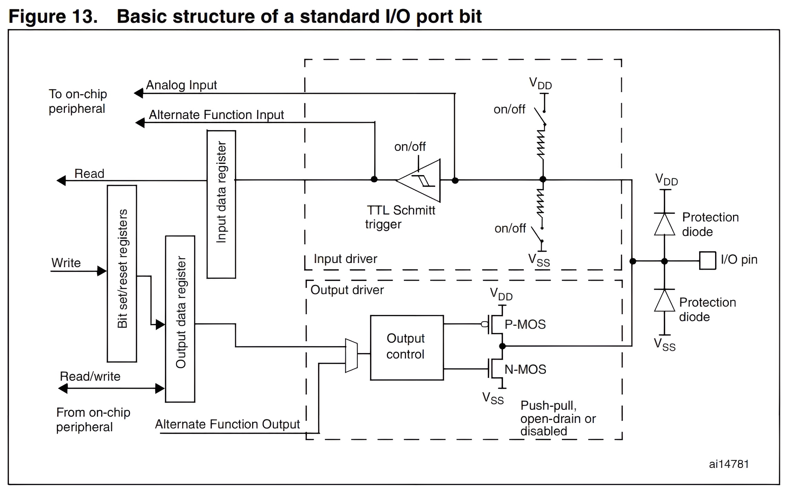
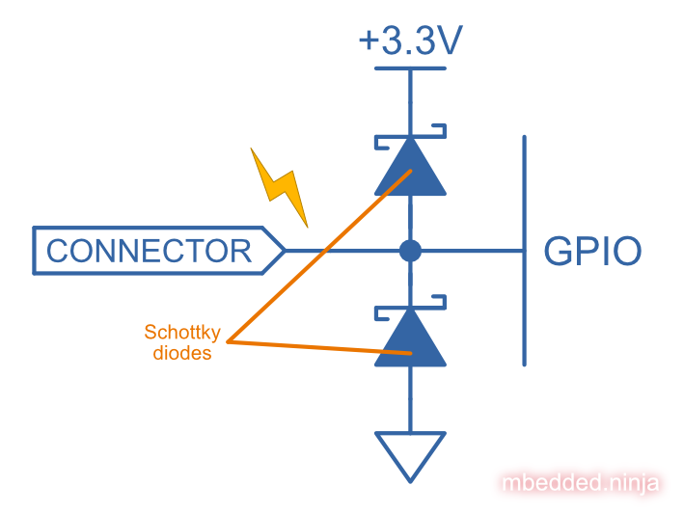
LAB 1: GPIO – LED – 7SEG IN DIRECT FORM
1. GPIO OF STM32F103C6
PROTECTED DIODE
STM32 EMBEDDED SYSTEMS
ARM CORTEX M

Slide 5
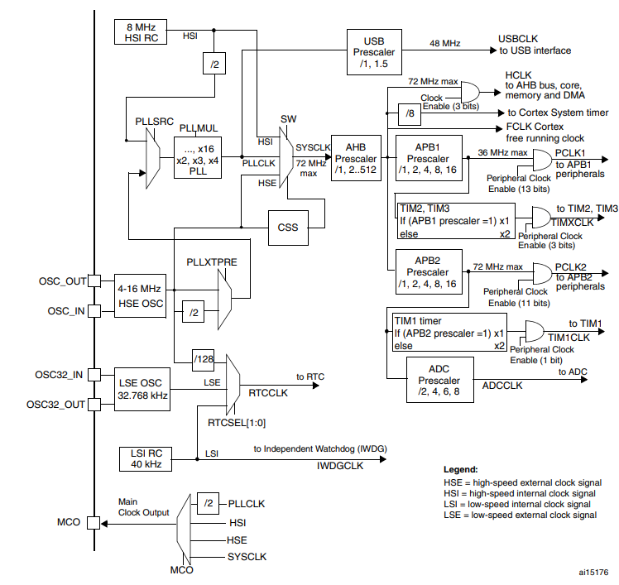
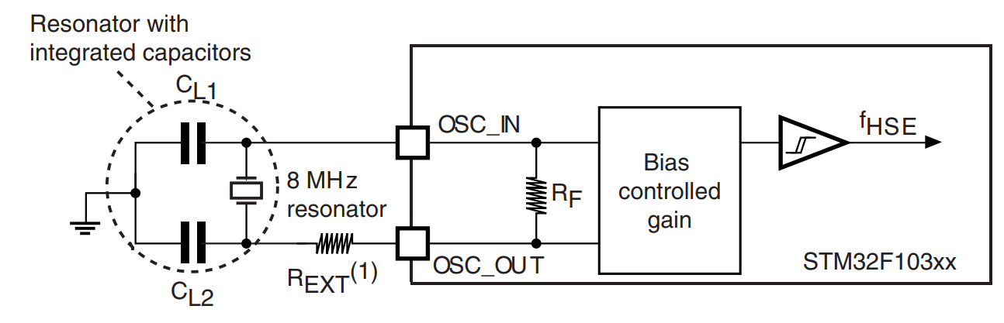
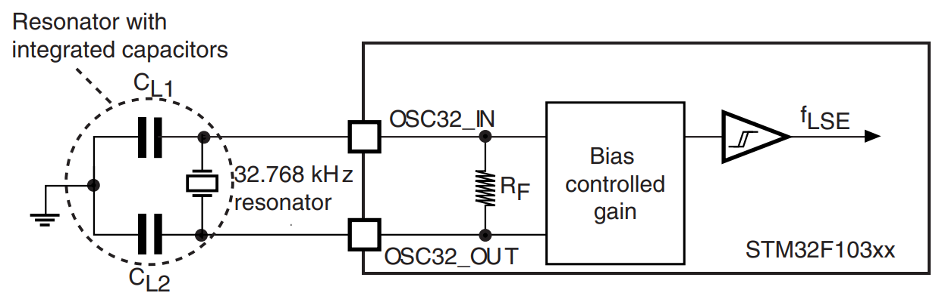
LAB 1: GPIO – LED – 7SEG IN DIRECT FORM
1. GPIO OF STM32F103C6
STM32 EMBEDDED SYSTEMS
ARM CORTEX M

Slide 6
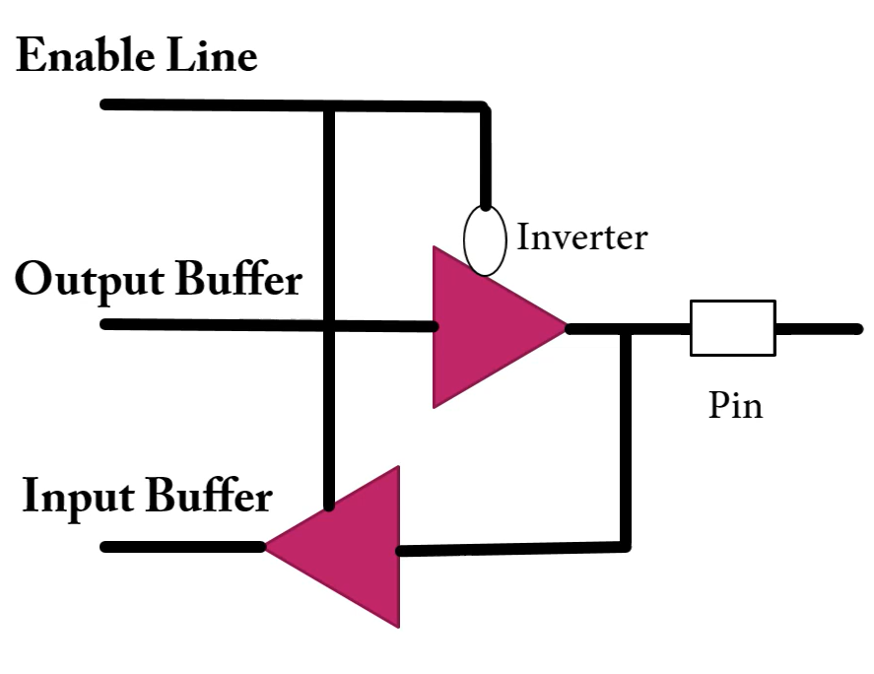
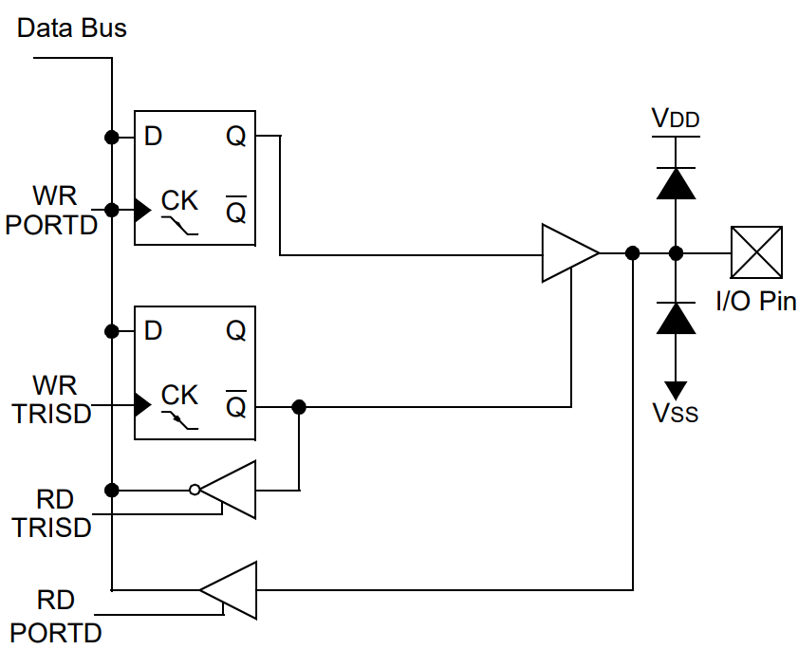
LAB 1: GPIO – LED – 7SEG IN DIRECT FORM
1. GPIO OF STM32F103C6
I/O STRUCTURE
IN PIC16F887
STM32 EMBEDDED SYSTEMS
ARM CORTEX M

Slide 7
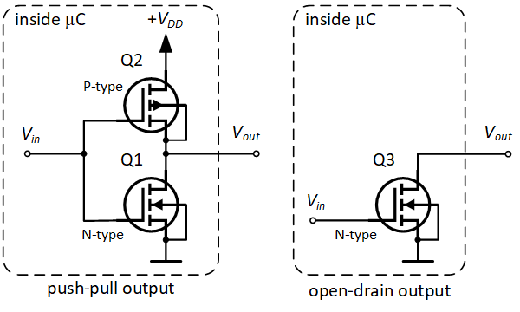
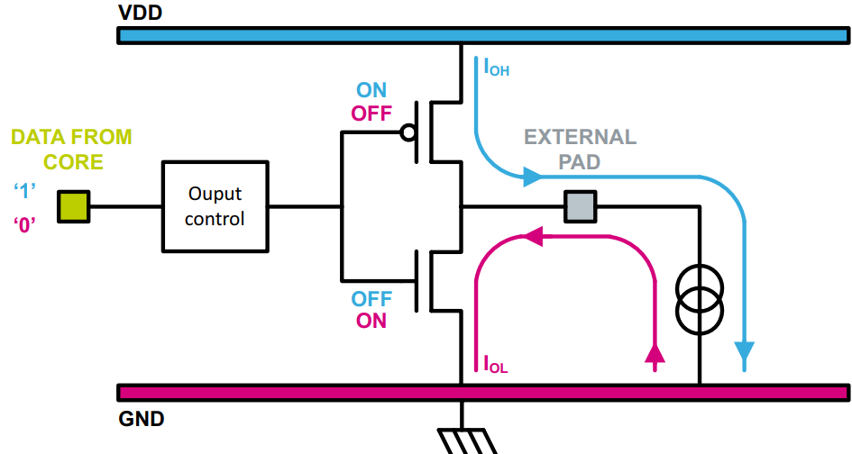
LAB 1: GPIO – LED – 7SEG IN DIRECT FORM
1. GPIO OF STM32F103C6
TYPE OF OUTPUT
OUTPUT PUSH – PULL
STM32 EMBEDDED SYSTEMS
ARM CORTEX M

Slide 8
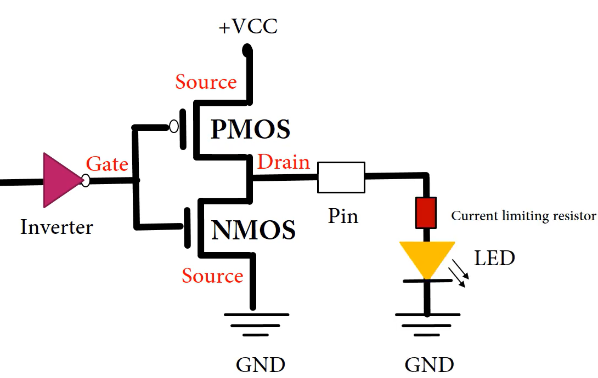
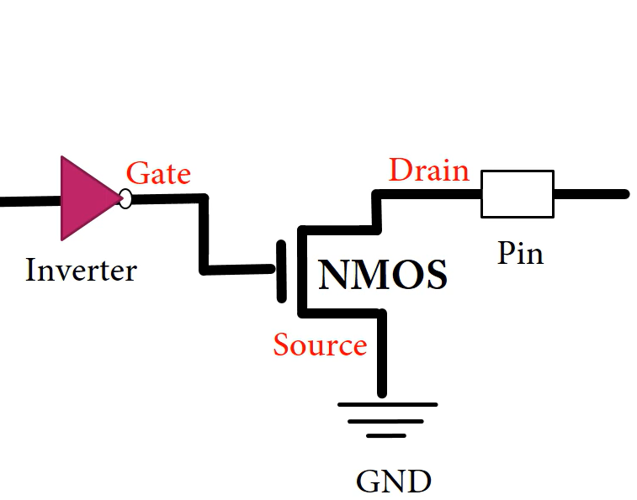
LAB 1: GPIO – LED – 7SEG IN DIRECT FORM
1. GPIO OF STM32F103C6
OUTPUT OPEN DRAIN
STM32 EMBEDDED SYSTEMS
ARM CORTEX M

Slide 9
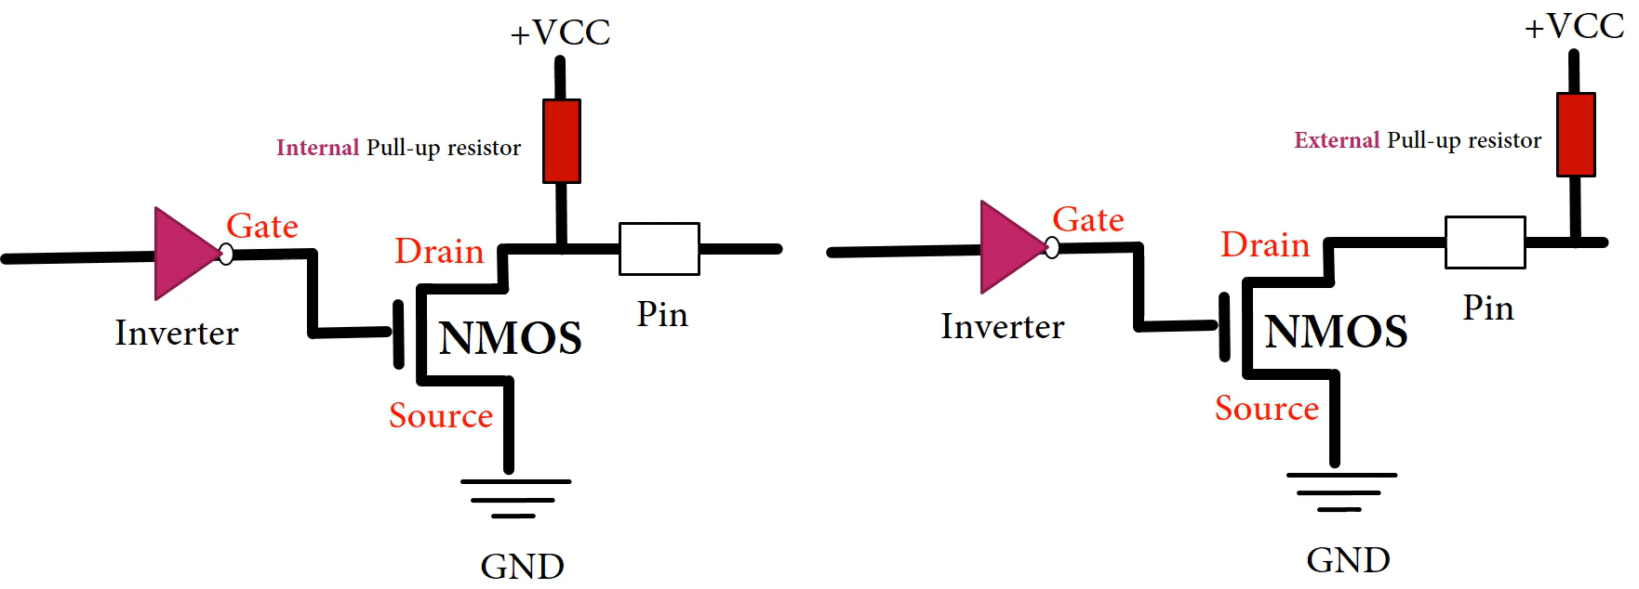
LAB 1: GPIO – LED – 7SEG IN DIRECT FORM
1. GPIO OF STM32F103C6
PULL UP RESISTOR
STM32 EMBEDDED SYSTEMS
ARM CORTEX M

Slide 10
LAB 1: GPIO – LED – 7SEG IN DIRECT FORM
2. HAL LIBRARY & COMMANDS
1. HAL_GPIO_WritePin(port, pin, state);
Write a bit to a GPIO pin.
Port in use: A, B, C,... GPIOA, GPIOB,...
Pin in use: 0 – 15, GPIO_PIN_0, GPIO_PIN_ALL,..
State in use: GPIO_PIN_SET, GPIO_PIN_RESET
STM32 EMBEDDED SYSTEMS
ARM CORTEX M

Slide 11
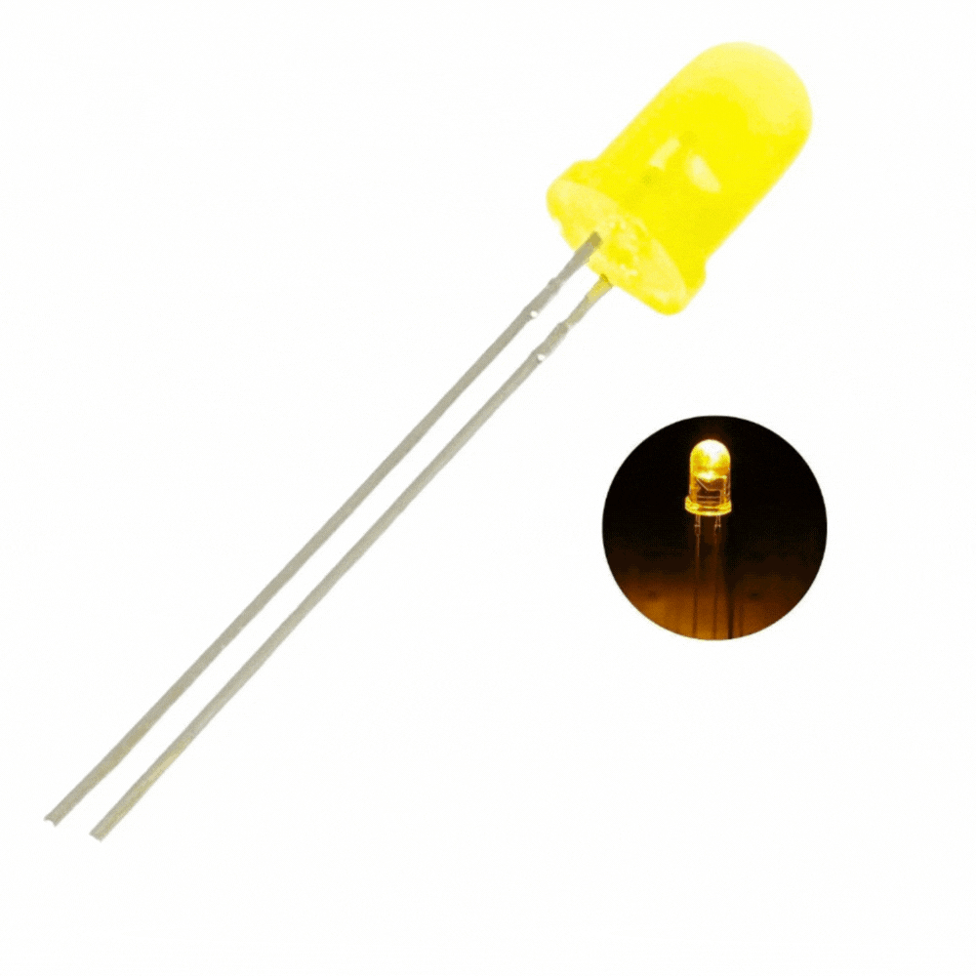
LAB 1: GPIO – LED – 7SEG IN DIRECT FORM
2. HAL LIBRARY & COMMANDS
2. HAL_GPIO_TogglePin(gpio,pin);
Toggle the status of a GPIO pin.
Port in use: A, B, C,... GPIOA, GPIOB,...
Pin in use: 0 – 15, GPIO_PIN_0, GPIO_PIN_ALL,..
A basic example to control the blinky led can be shown as below
HAL_GPIO_TogglePin(GPIOA, GPIO_PIN_5);
HAL_Delay(2000);
STM32 EMBEDDED SYSTEMS
ARM CORTEX M

Slide 12

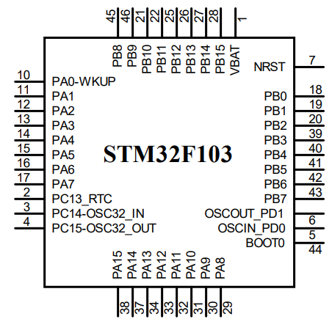
LAB 1: GPIO – LED – 7SEG IN DIRECT FORM
Write a function “Output_byte(data)” to put 1 byte data into 8 GPIO pins respectively B9 down to B2 with MSB of B9.
1 | 0 | 1 | 1 | 0 | 0 | 1 | 0
1 | 0 | 0 | 0 | 0 | 0 | 0 | 0
1 | 0 | 0 | 0 | 0 | 0 | 0 | 0
→ MSB = 1
1 | 0 | 1 | 1 | 0 | 0 | 1 | 0
0 | 0 | 0 | 0 | 0 | 0 | 0 | 1
0 | 0 | 0 | 0 | 0 | 0 | 0 | 0
→ LSB = 0
STM32 EMBEDDED SYSTEMS
ARM CORTEX M

Slide 13
LAB 1: GPIO – LED – 7SEG IN DIRECT FORM
Write a function “Output_byte(data)” to put 1 byte data into 8 GPIO pins respectively B9 down to B2 with MSB of B9.
void output_byte(uint8_t data)
{
HAL_GPIO_WritePin(GPIOB, GPIO_PIN_9,(GPIO_PinState)(data&128)); HAL_GPIO_WritePin(GPIOB, GPIO_PIN_8,(GPIO_PinState)(data&64)); HAL_GPIO_WritePin(GPIOB, GPIO_PIN_7,(GPIO_PinState)(data&32)); HAL_GPIO_WritePin(GPIOB, GPIO_PIN_6,(GPIO_PinState)(data&16)); HAL_GPIO_WritePin(GPIOB, GPIO_PIN_5,(GPIO_PinState)(data&8)); HAL_GPIO_WritePin(GPIOB, GPIO_PIN_4,(GPIO_PinState)(data&4)); HAL_GPIO_WritePin(GPIOB, GPIO_PIN_3,(GPIO_PinState)(data&2)); HAL_GPIO_WritePin(GPIOB, GPIO_PIN_2,(GPIO_PinState)(data&1));
}
STM32 EMBEDDED SYSTEMS
ARM CORTEX M

Slide 14
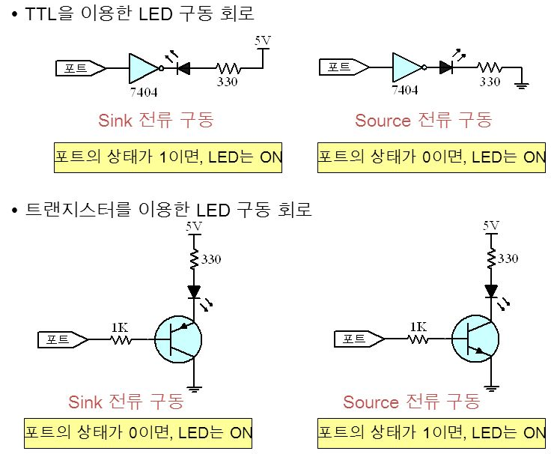
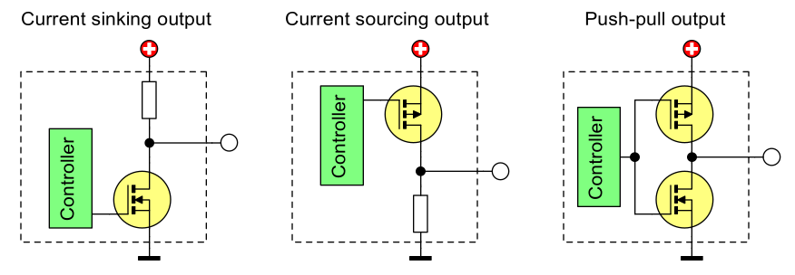
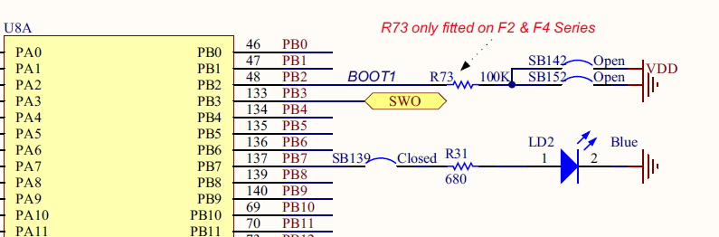
LAB 1: GPIO – LED – 7SEG IN DIRECT FORM
3. CONTROL LED & 7 SEG IN PARALLEL
Sink and Source current!
STM32 EMBEDDED SYSTEMS
ARM CORTEX M

Slide 15
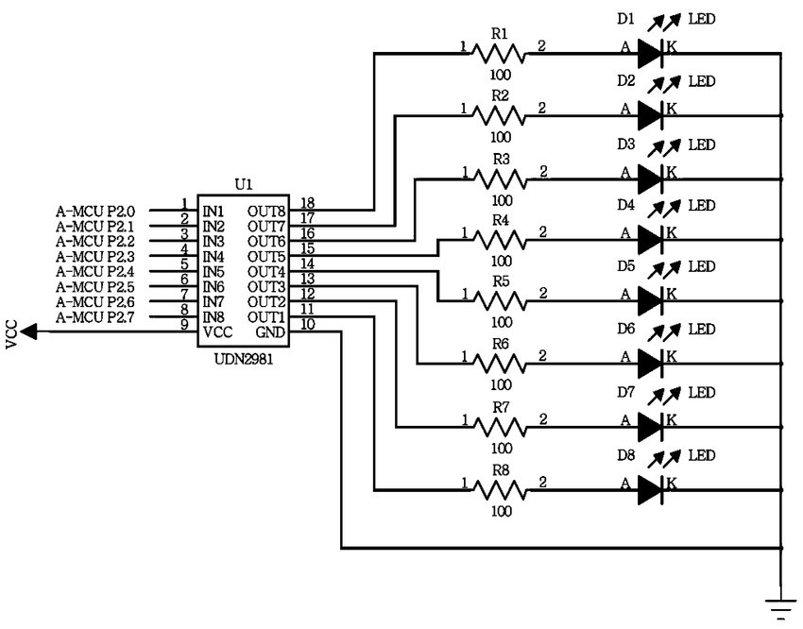
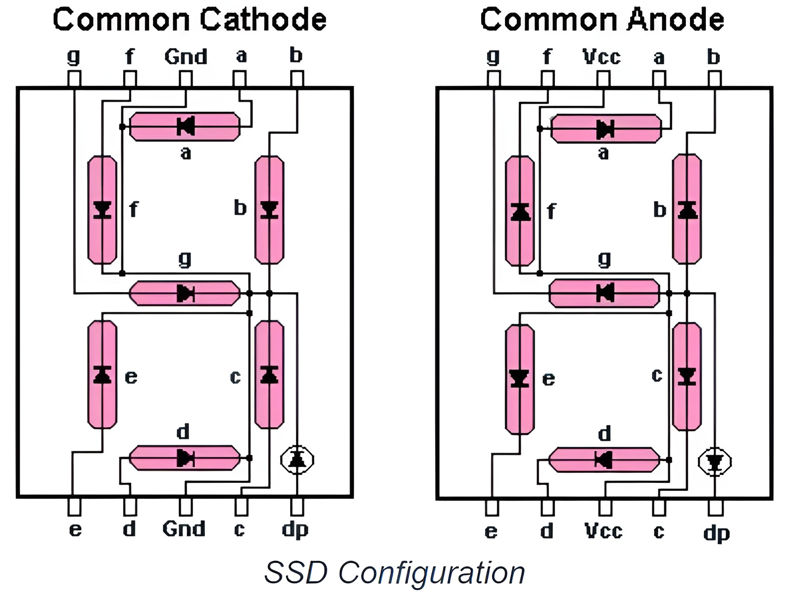
LAB 1: GPIO – LED – 7SEG IN DIRECT FORM
3. CONTROL LED & 7 SEG IN PARALLEL
7 SEGMENT LED
STM32 EMBEDDED SYSTEMS
ARM CORTEX M

Slide 16
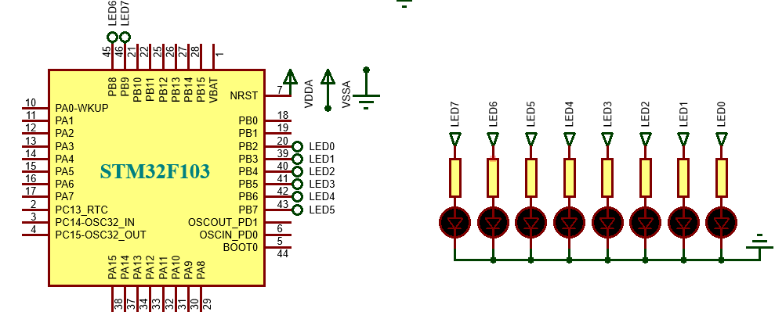
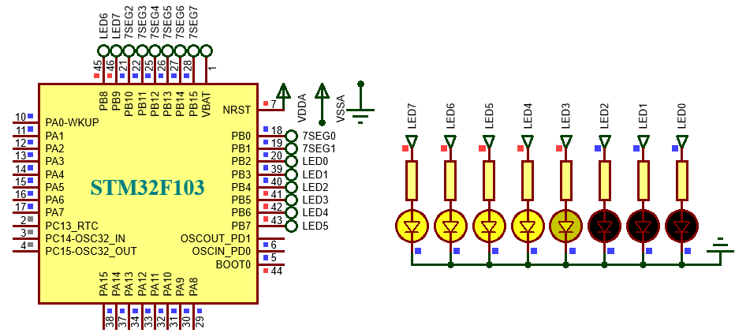
LAB 1: GPIO – LED – 7SEG IN DIRECT FORM
3. CONTROL LED & 7 SEG IN PARALLEL
Write a program to control 8 leds are connected as before. The effects are include:
+ One point of light is shifting from left to right and vice versal.
+ The LEDs sequentially illuminate from left to right.
The entire process repeats indefinitely. The time variation is 200 milliseconds.
STM32 EMBEDDED SYSTEMS
ARM CORTEX M

Slide 17
LAB 1: GPIO – LED – 7SEG IN DIRECT FORM
3. CONTROL LED & 7 SEG IN PARALLEL
for(i=0; i<=8; i++)
{
led = 0x80 >> i; output_byte(led); HAL_Delay(200);
}
for(i=0; i<=8; i++)
{
led = 0x01 << i; output_byte(led); HAL_Delay(200);
}
for(i=0; i<=8; i++)
{
led = ~(0xff >> i); output_byte(led); HAL_Delay(200);
}
for(i=0; i<=8; i++)
{
led = ~(0xff << i); output_byte(led); HAL_Delay(200);
}
STM32 EMBEDDED SYSTEMS
ARM CORTEX M

Slide 18
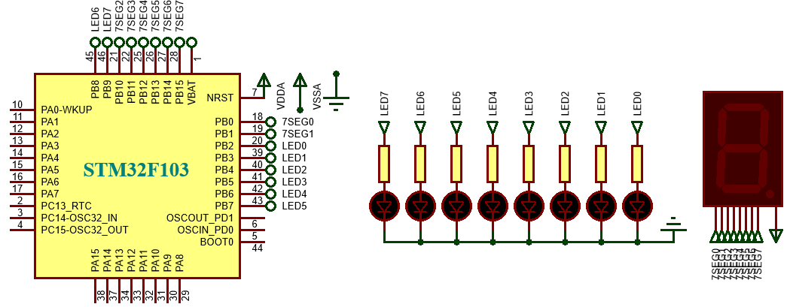
LAB 1: GPIO – LED – 7SEG IN DIRECT FORM
3. CONTROL LED & 7 SEG IN PARALLEL
Write more a function “output_7seg(data);” to display the numbers form 0 to 9 on 7 segment led connected to the remaining pins of port B. Now 8 LEDs are blinky with the time of 1 seconds.
STM32 EMBEDDED SYSTEMS
ARM CORTEX M

Slide 19
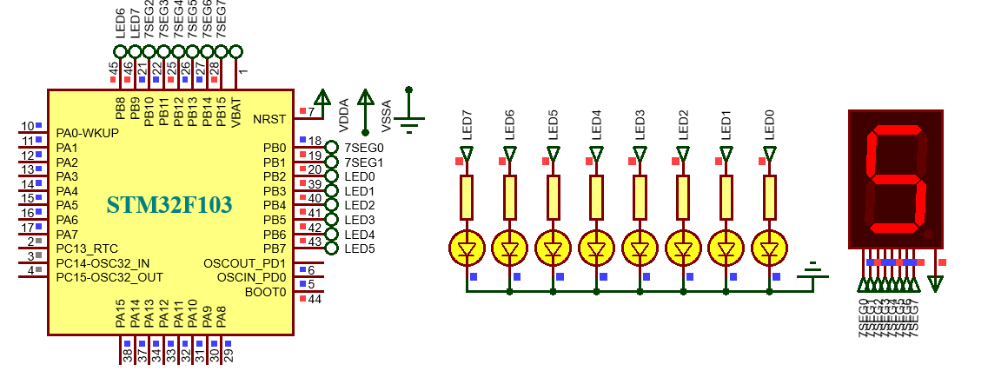
LAB 1: GPIO – LED – 7SEG IN DIRECT FORM
3. CONTROL LED & 7 SEG IN PARALLEL
char numc[10]=
{0xc0,0xf9,0xa4,0xb0,0x99,0x92,0x82,0xf8,0x80,0x90};
led = ~led; output_byte(led); HAL_Delay(1000);
count ++;
count %= 10; output_7seg(numc[count]);
STM32 EMBEDDED SYSTEMS
ARM CORTEX M

Slide 20
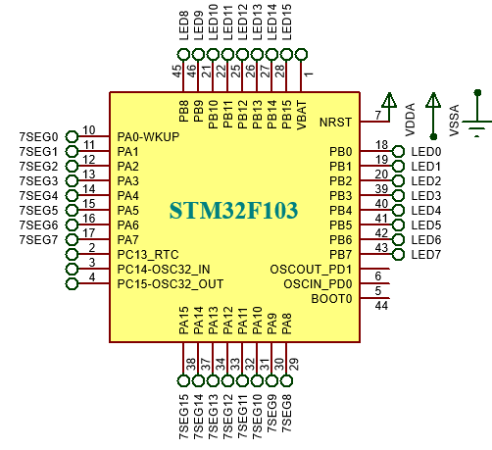


LAB 1: GPIO – LED – 7SEG IN DIRECT FORM
4. CONTROL LED & 7 SEG IN SERIAL
NEED TO 16 LEDS OR 2 SEVEN SEGMENT LED?
TOO MANY CONNECTION!
STM32 EMBEDDED SYSTEMS
ARM CORTEX M

Slide 21
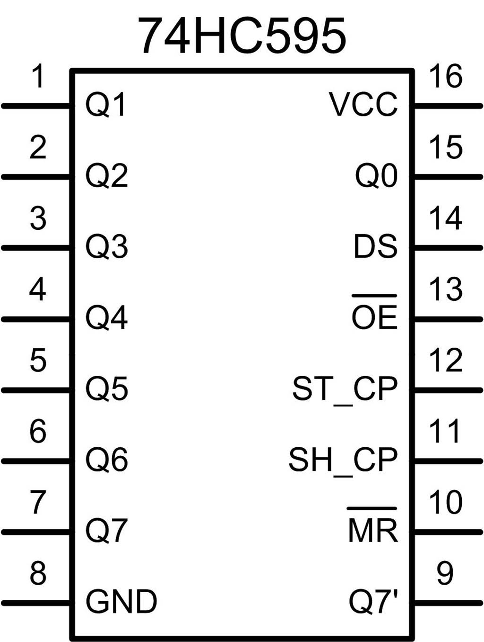
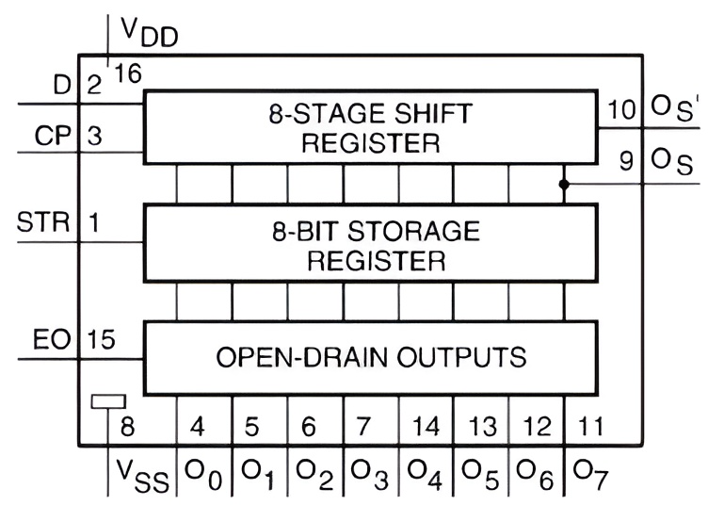
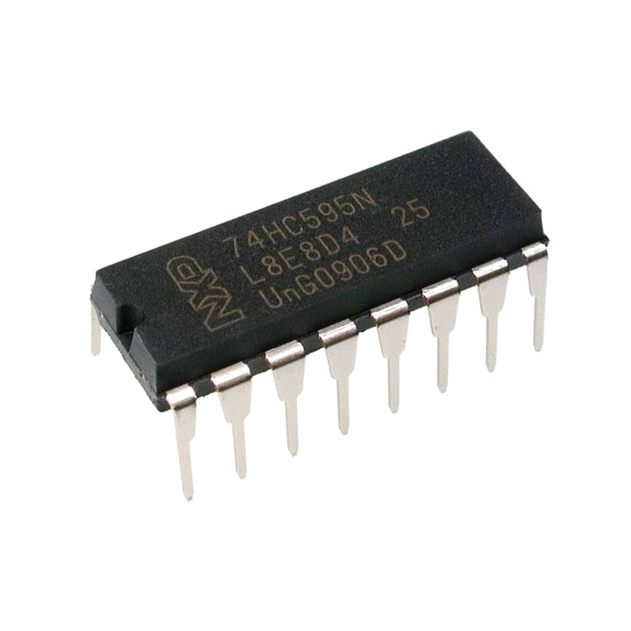
LAB 1: GPIO – LED – 7SEG IN DIRECT FORM
4. CONTROL LED & 7 SEG IN SERIAL
NEED TO TRANSFORM PARALLEL TO SERIAL → 74HC595
STM32 EMBEDDED SYSTEMS
ARM CORTEX M

Slide 22
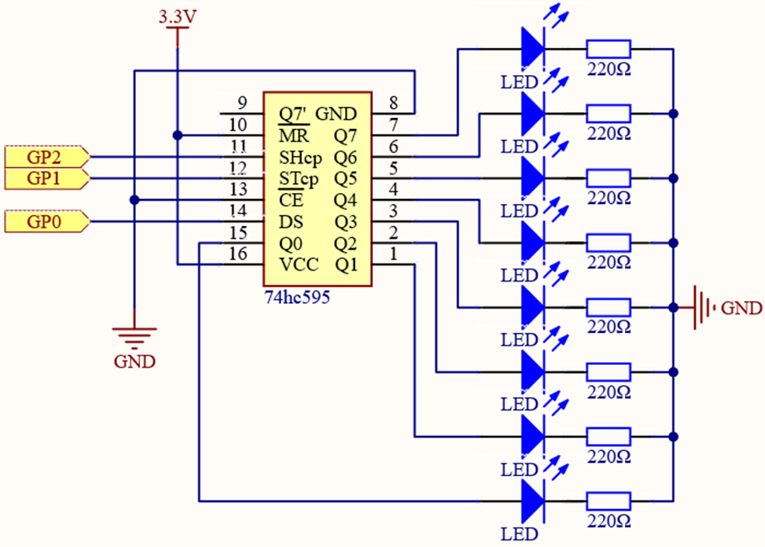
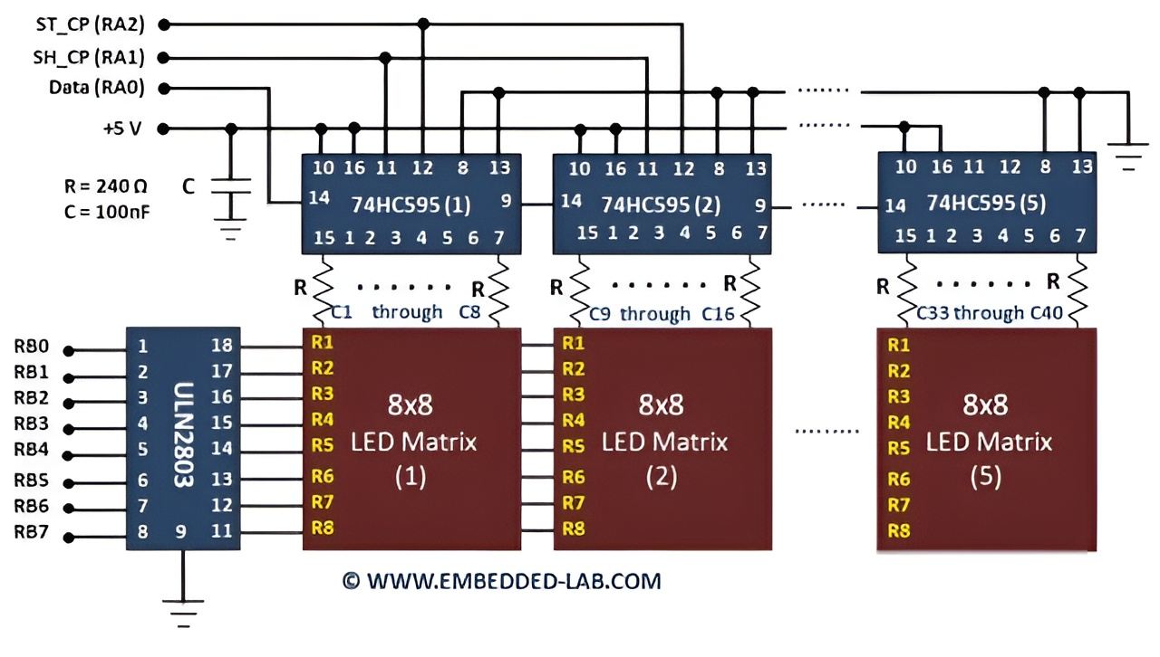
LAB 1: GPIO – LED – 7SEG IN DIRECT FORM
4. CONTROL LED & 7 SEG IN SERIAL
NEED TO TRANSFORM PARALLEL TO SERIAL → 74HC595
STM32 EMBEDDED SYSTEMS
ARM CORTEX M

Slide 23
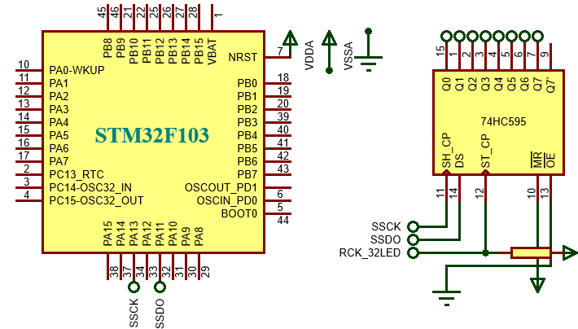
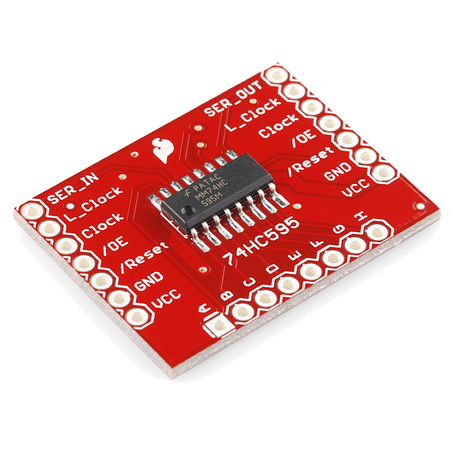

LAB 1: GPIO – LED – 7SEG IN DIRECT FORM
Write a function “Put_1byte(data)” to put 1 byte data into the serial data output at GPIO pin A11 and then the data is shifted to the stored register of IC 74HC595.
CAN NOT GET FULL OF DATA!
void put1_byte(uint8_t byte)
{ for(uint8_t i = 0; i < 8; i++)
HAL_GPIO_WritePin(GPIOA,GPIO_PIN_11,(GPIO_PinState)(byte&(0x80 >> i)));
}
STM32 EMBEDDED SYSTEMS
ARM CORTEX M

Slide 24
LAB 1: GPIO – LED – 7SEG IN DIRECT FORM
Write a function “Put_1byte(data)” to put 1 byte data into the serial data output at GPIO pin A11 and then the data is shifted to the stored register of IC 74HC595.
void put1_byte(uint8_t byte)
{
for(uint8_t i = 0; i < 8; i++)
{
HAL_GPIO_WritePin(GPIOA,GPIO_PIN_11,(GPIO_PinState)(byte&(0x80 >> i)));
HAL_GPIO_WritePin(GPIOA, GPIO_PIN_13, GPIO_PIN_SET );
HAL_GPIO_WritePin(GPIOA, GPIO_PIN_13, GPIO_PIN_RESET );
}
}
STM32 EMBEDDED SYSTEMS
ARM CORTEX M

Slide 25
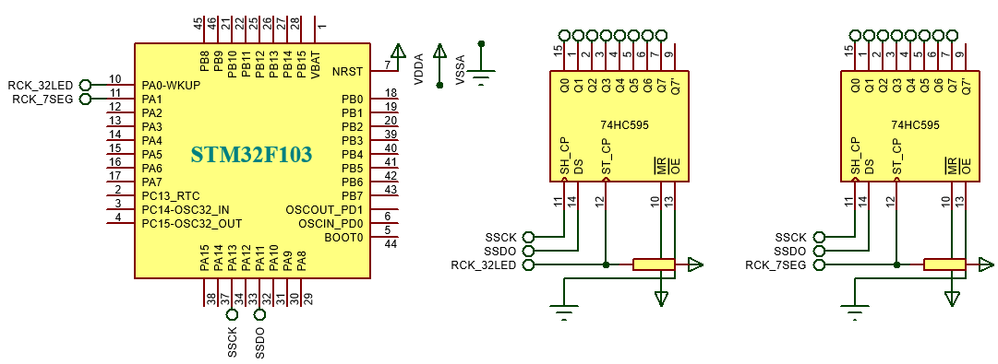

LAB 1: GPIO – LED – 7SEG IN DIRECT FORM
4. CONTROL LED & 7 SEG IN SERIAL
The RCK signal acts as the enable signal for determining which module can receive data.
STM32 EMBEDDED SYSTEMS
ARM CORTEX M

Slide 26
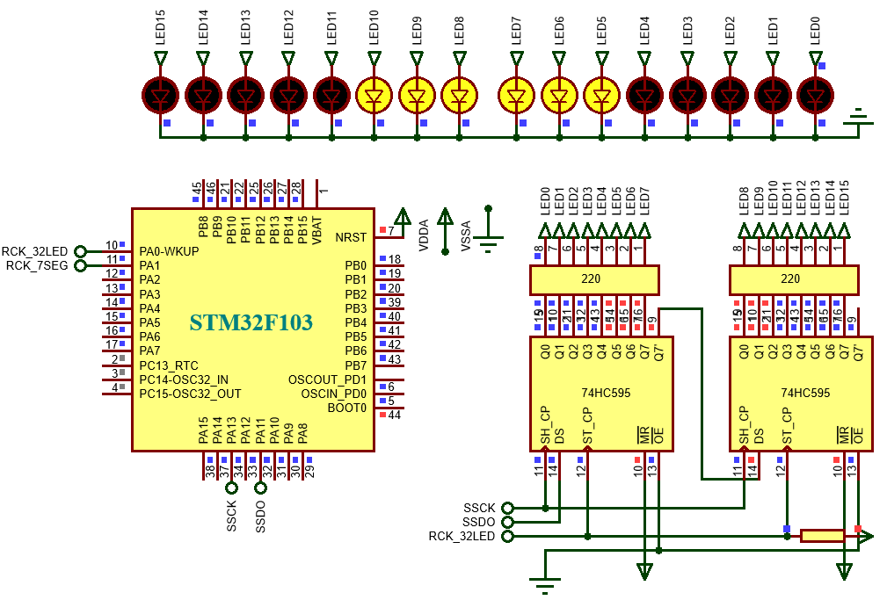
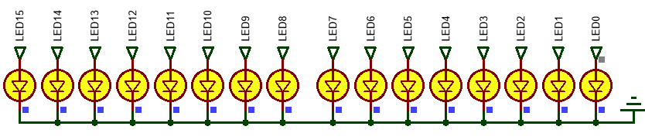
LAB 1: GPIO – LED – 7SEG IN DIRECT FORM
4. CONTROL LED & 7 SEG IN SERIAL
Write a function “led_16display()” to put 2 byte data1 and data2 to the output of 74HC595 so that we can control 16 leds. The process is include:
+ 16 LED blink every 200ms, repeated twice.
+ The LEDs sequentially illuminate from inside to outside.
STM32 EMBEDDED SYSTEMS
ARM CORTEX M

Slide 27
LAB 1: GPIO – LED – 7SEG IN DIRECT FORM
for(i=0; i<2; i++)
{
led8_led[1] = 0xff; led8_led[0] = 0xff; led16_display(); HAL_Delay(200);
led8_led[1] = 0;
led8_led[0] = 0; led16_display(); HAL_Delay(200);
}
for(i=0; i<=8; i++)
{
led8_led[1] = ~(0xff << i); led8_led[0] = ~(0xff >> i); led16_display(); HAL_Delay(200);
}
STM32 EMBEDDED SYSTEMS
ARM CORTEX M

Slide 28
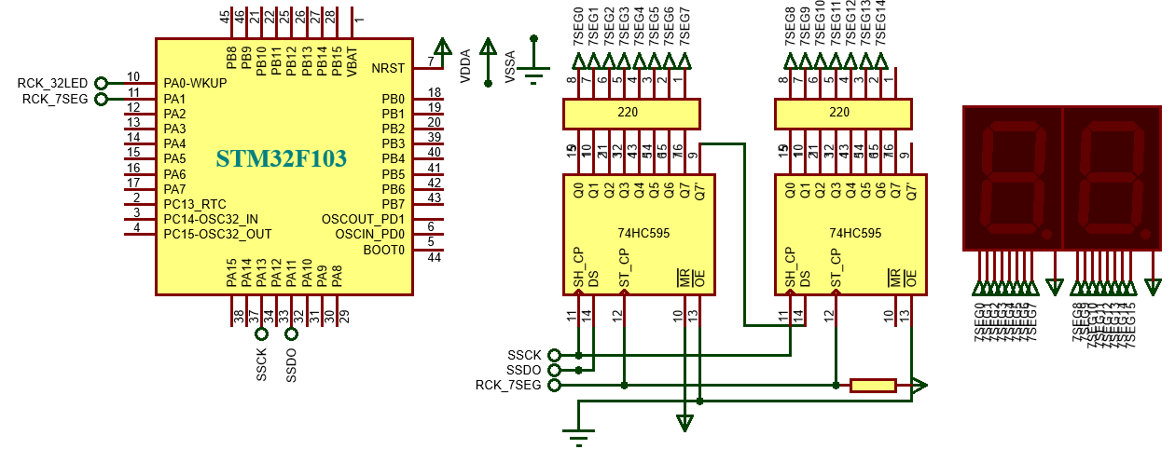
LAB 1: GPIO – LED – 7SEG IN DIRECT FORM
4. CONTROL LED & 7 SEG IN SERIAL
Write a function “led7seg_display()” to put 2 byte data1 and data2
to the output of 74HC595 so that we can display 2 digit from 00 – 99.
STM32 EMBEDDED SYSTEMS
ARM CORTEX M

Slide 29
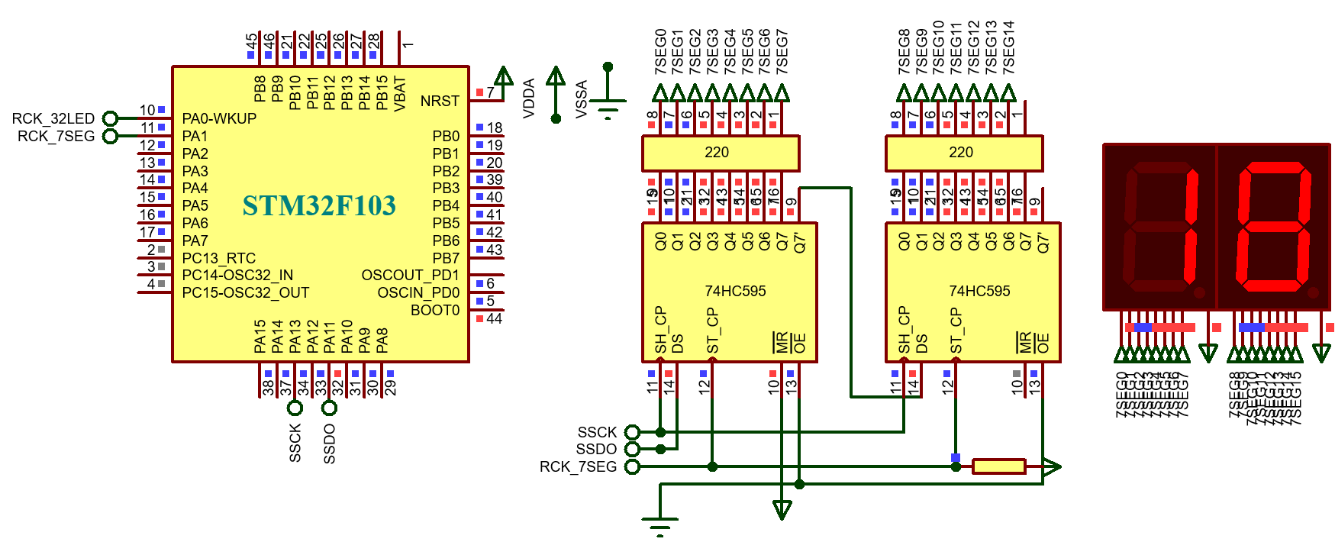
LAB 1: GPIO – LED – 7SEG IN DIRECT FORM
4. CONTROL LED & 7 SEG IN SERIAL
led7_seg[0] = numc[count/10]; led7_seg[1] = numc[count%10];
led7seg_display(); HAL_Delay(200);
count ++;
count %= 100;
STM32 EMBEDDED SYSTEMS
ARM CORTEX M

Slide 30
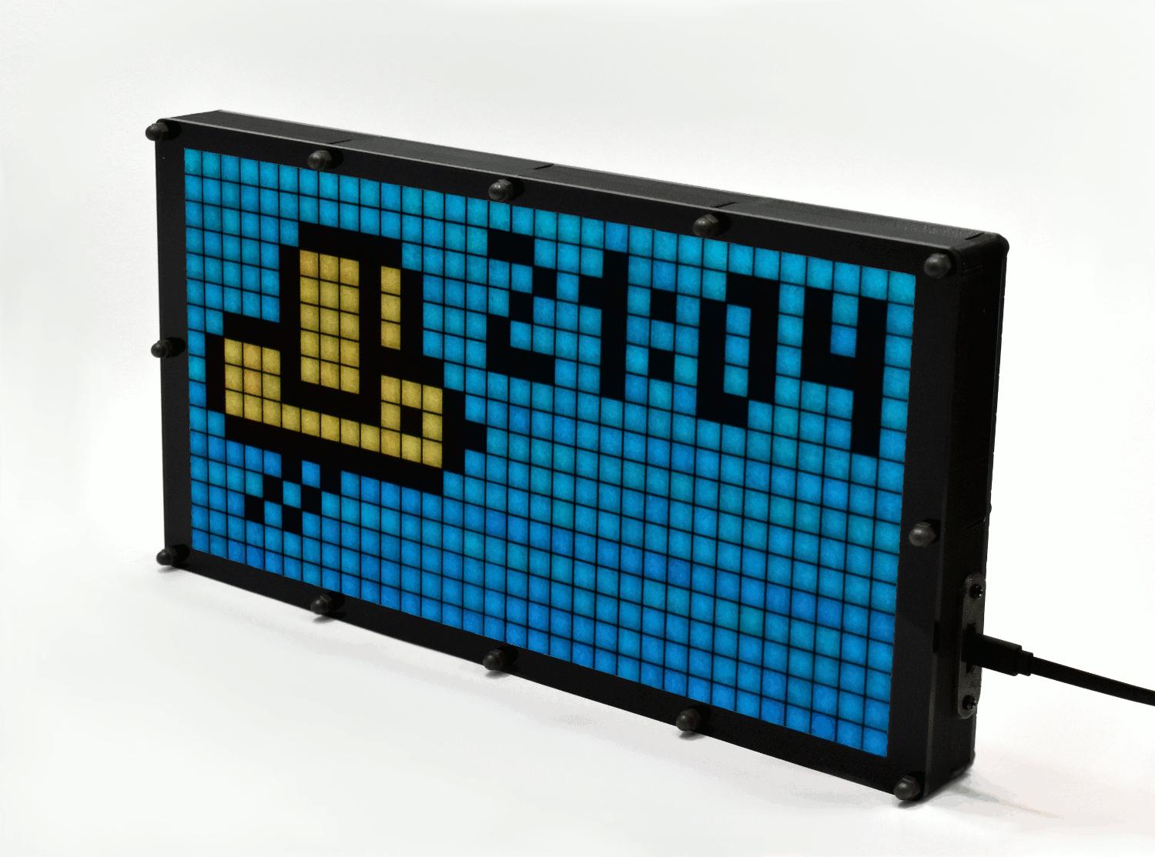
LAB 1: GPIO – LED – 7SEG IN DIRECT FORM
BOARD PRACTISE
led16_led[2];
led16_led[1];
uint16_t led16_led[2];
void led32_display();
STM32 EMBEDDED SYSTEMS
ARM CORTEX M

Slide 31
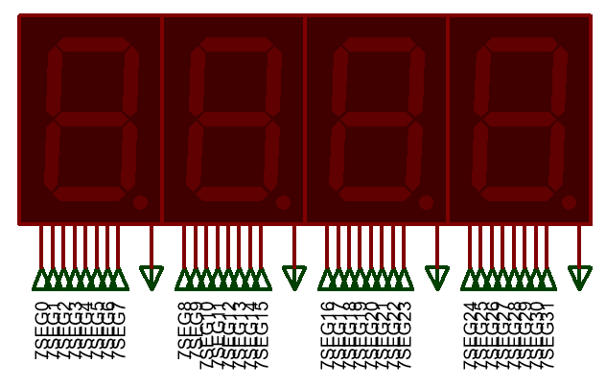
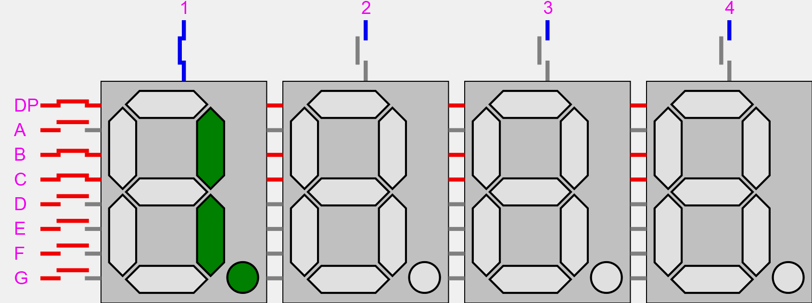
LAB 1: GPIO – LED – 7SEG IN DIRECT FORM
BOARD PRACTISE
led7_seg[0];
led7_seg[1];
led7_seg[2];
led7_seg[3];
uint8_t led7_seg[4];
void led7seg_display();
STM32 EMBEDDED SYSTEMS
ARM CORTEX M

